Slide 1
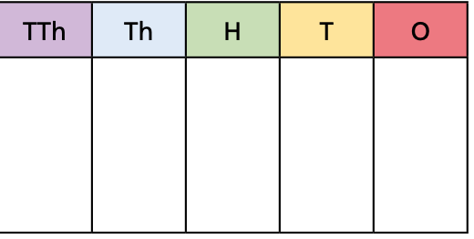
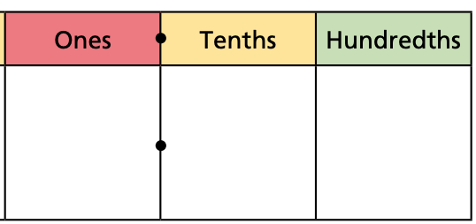
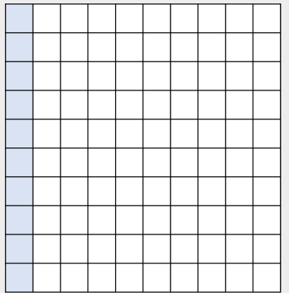
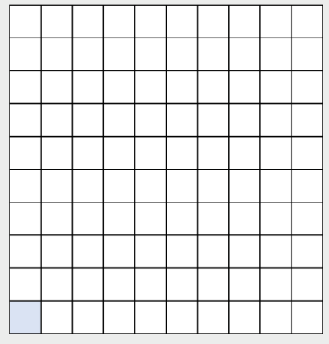
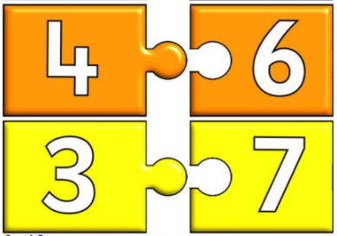

Mathematics
Place value and proportion
Year 7
Term 2
1: 8 times table | 2: Integer place value | 3: Decimal place value
4: Compare and Order | 5: FDP conversion | 6: Addition and subtraction
Integer - a whole number
Example Non example
1 0.5
Decimal - A number containing part of a whole
1 x 8 = 8
2 x 8 = 16
3 x 8 = 24
4 x 8 = 32
5 x 8 = 40
6 x 8 = 48
7 x 8 = 56
8 x 8 = 64
9 x 8 = 72
10 x 8 = 80
11 x 8 = 88
12 x 8 = 96
Example Non example
0.5 1
Place value - The value each digit of a given number holds
Decimal point - Separates the integer and non-integer parts of a number
1000
10
1
3 ones = 3
2 tens = 20
2 thousands = 2000
3 tenths = 0.3
5 hundredths = 0.05
0.3 + 0.05 = 0.35
10
1
0.1
0.1
0.01
0.01
1000
1
0.1
0.01
0.01
2 0 2 3
0.01
Place holder
0 . 3 5
Range – measurement of how spread out a list of numbers is. It is the difference between the largest and smallest value.
2, 5, 6, 6, 7, 8, 10 The range is 10 – 2 = 8
Greater than – inequality used to compare two or more numbers, quantities or value.
Symbol used is > e.g. 5 > 3 5 is greater than 3
Less than - inequality used to compare two or more numbers, quantities or value.
Symbol used is < e.g. 3 < 7 3 is less than 7
Median – is the ‘middle’ of a sorted list of numbers.
Sum – The result of an addition of two or more values.
E.g. The sum of 8, 2 and 5 is 8 + 2 + 5 = 15
Associative Law – means it doesn’t matter what we calculate first (how we group the numbers).
Number bonds – are pairs of numbers that can be added together to make another number.
Number bonds to 10:
4 + 6 = 10
3 + 7 = 10
etc
A tenth = $\frac{1}{10}=0.1$
A hundredth = $\frac{1}{100}=0.01$
Percent - Out of one hundred.
$$\frac{5}{100}=5\% \frac{15}{100}=15\%$$

